Slide 1
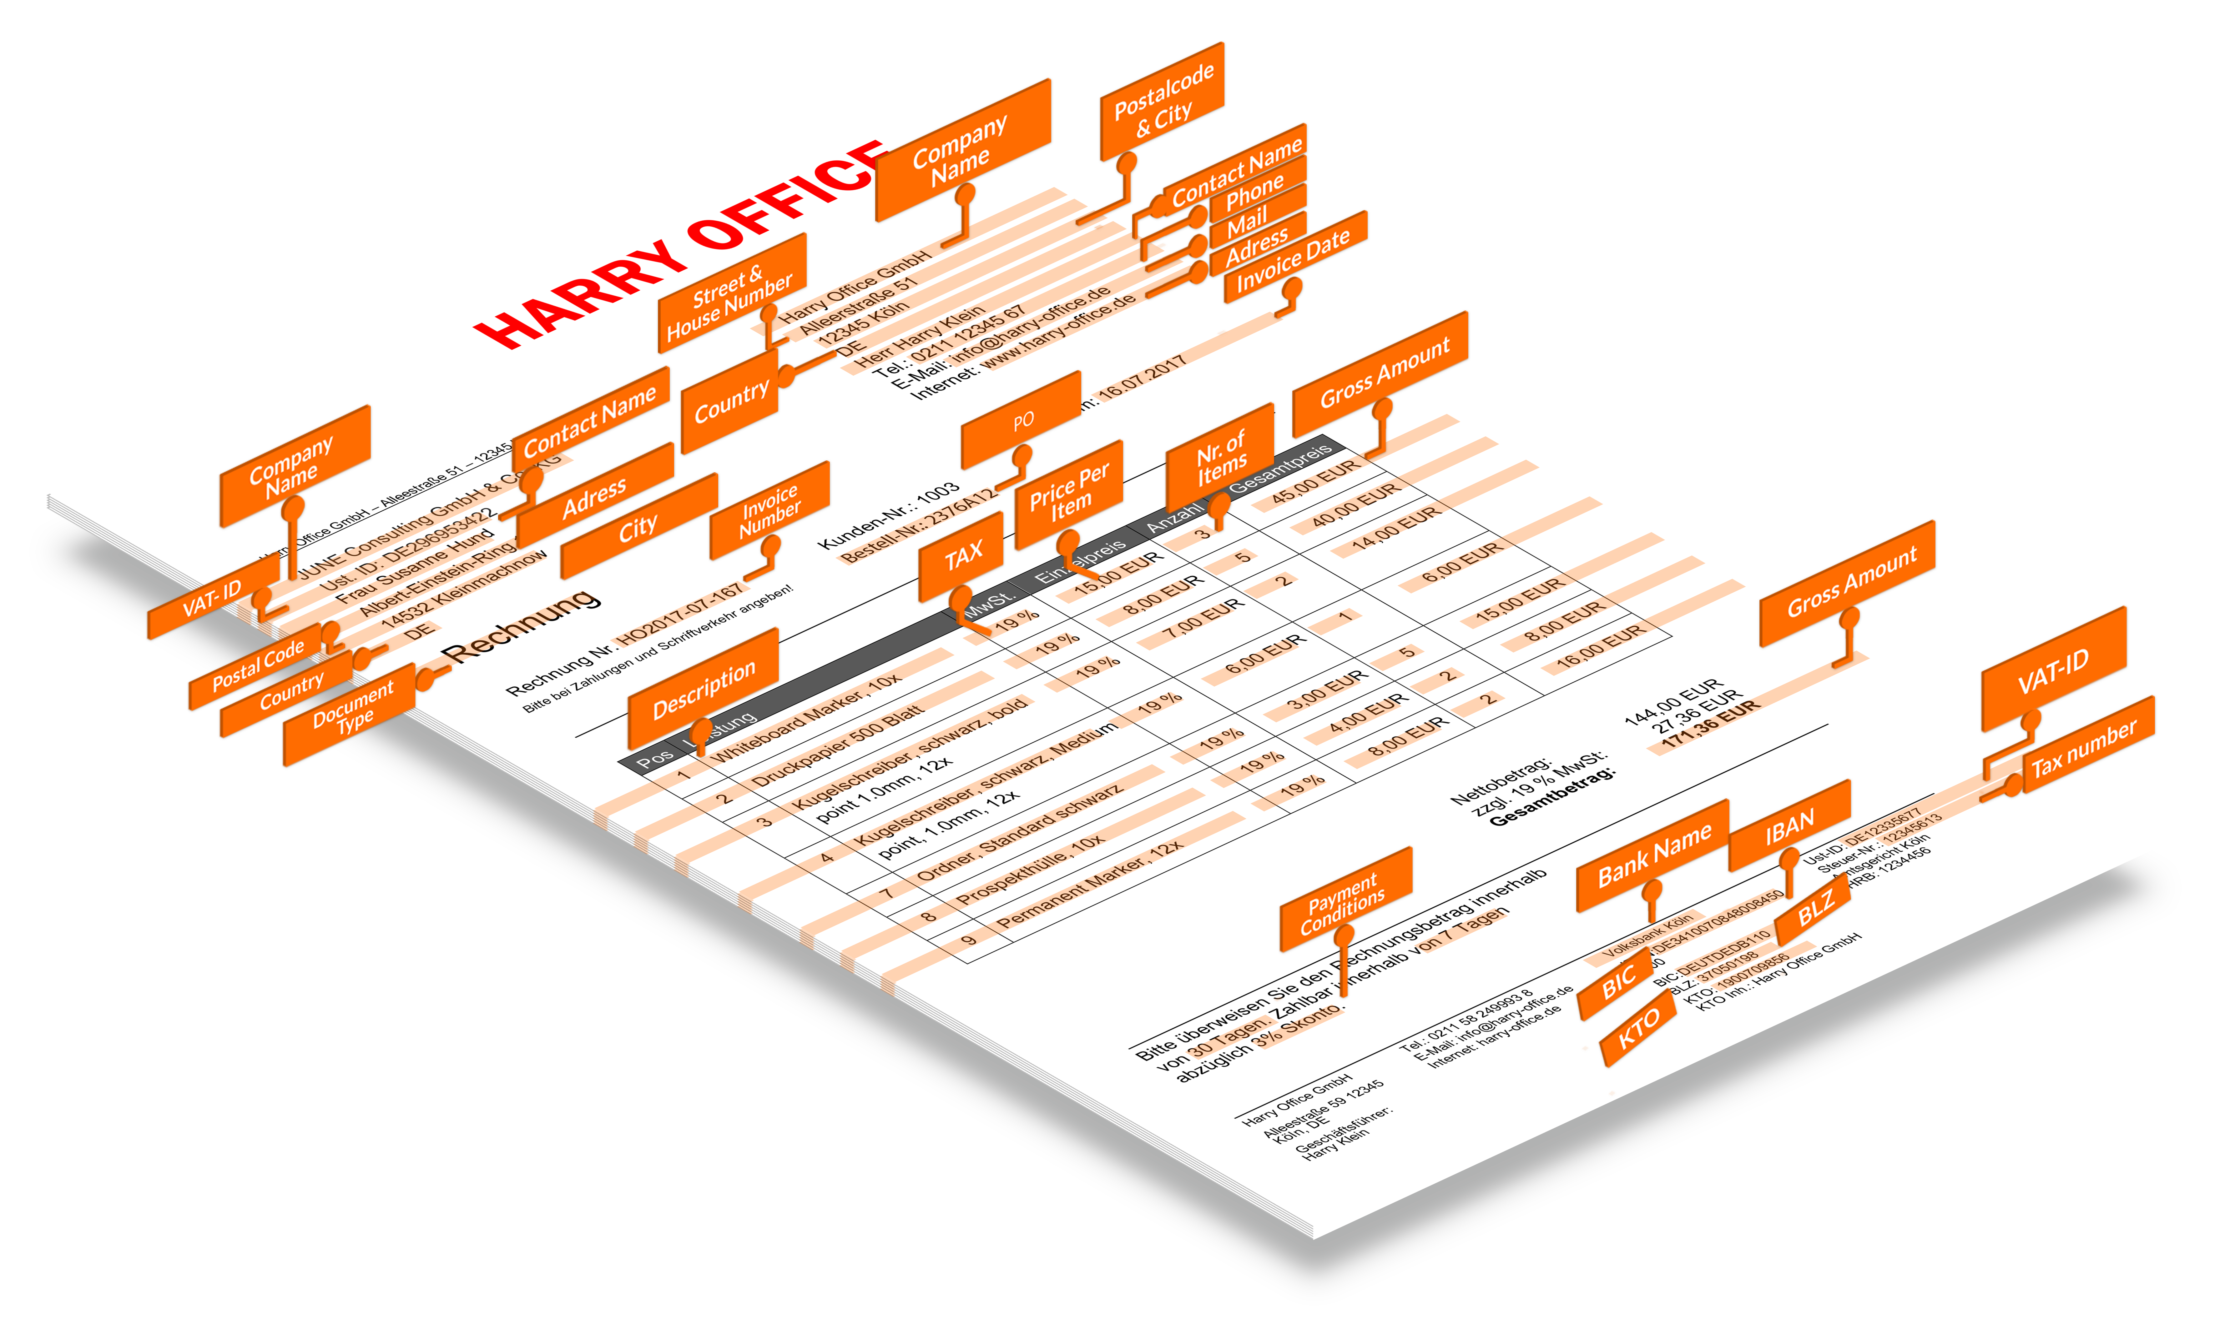
Problem SMACC solves

Slide 2
Clients report substantial efficiency gains
12 days
>5 USD
3 %
- 95 %
-80 %
-65 %
<1 %
1.5 USD
0.5 days
w/o
SMACC
with
SMACC
w/o
SMACC
with
SMACC
w/o
SMACC
with
SMACC
Processing time
per invoice
Processing costs
Per invoice
Error rates
2
Quelle: PWC Study; SMACC customer results
Notes:
Here are what our customers report to us: We can drastically.

Slide 3








Global clients
3
Notes:
Our technology is so successfull that we have clients of all size in all different verticals: from big enterprises to startups.
We are very proud that Deutsche Bank for example, ….
Biggest help insurer in Germany: AOK. They get 100s of thousands of invoices every year, and half of their staff is approaching retirement age. They were looking for technology such as ours.
In the startup space we have HelloFresh.
In fact we‘re so successfull that those big consulting and accounting firm not only showcase our technology, but buy our technoogy whitelabelled to be used in their client projects!

